Slide 1
Cross-age Face Generation
Huajie Jiang、Lin Wang
Huifeng Dong、Jiafei Song
May.2017

Slide 2
Content List
Definition
Applications
Related Work
Approach
Experiment

Slide 3
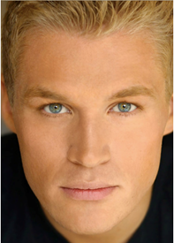
Definition
Cross-age Face Generation
5
？
Generator
18
？
40

Slide 4
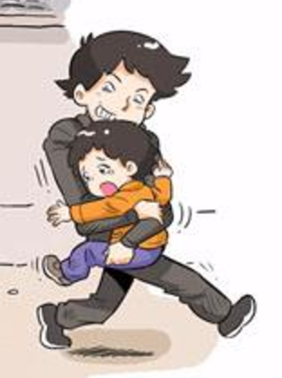
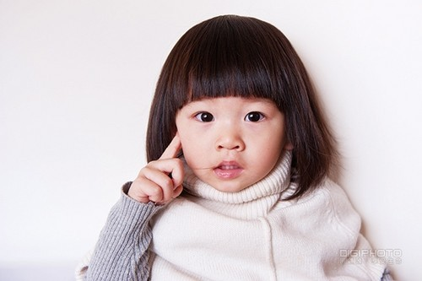
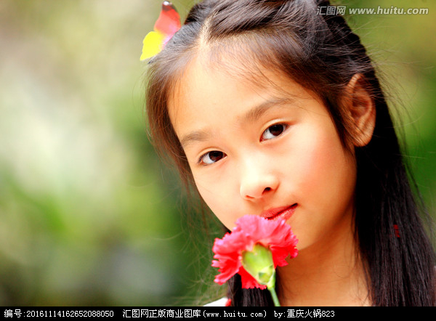
Application (1/2)
Finding Lost Children
Current
5 years later
abducted child

Slide 5


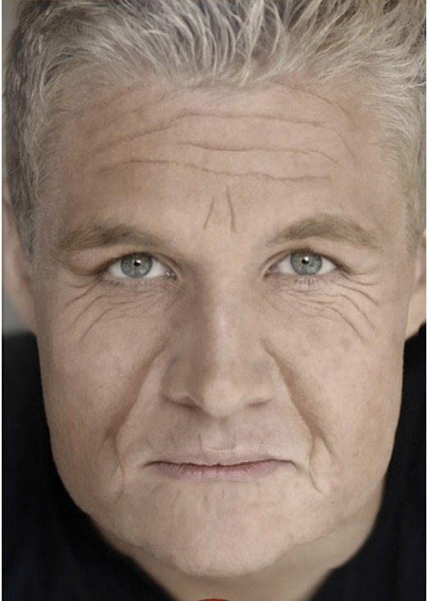
Application (2/2)
Entertainment
20
？
？
0
100
？
？

Slide 6
Related Work (1/4)
Traditional
Physical model-based
model biological facial change with age (muscle, wrinkle, skin)
Complex modeling
Sufficient dataset to cover long time span
computationally expensive;
Prototype-based
learn a transformation between groups
ghosting artifacts
lose personality
paired samples over short time span

Slide 7
Related Work (2/4)
Deep Learning
Generative Adversarial Network(GAN)
G: Generator
D: Discriminator
I : Image
I_G: Generated Image
G
I_G
Z
D
T or F
I

Slide 8
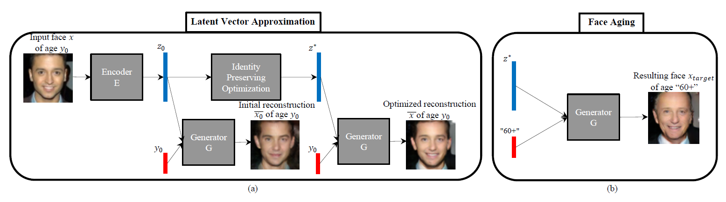
Related Work (3/4)
Deep learning
Age Conditional Generative Adversarial Network (acGAN)
Framework: encoder->decoder
Novelty: optimize latent vector
Grigory Antipov, Moez Baccouche, Jean-Luc Dugelay. Face Aging With Convolutional Generative Adversarial Networks. ICIP, 2017.

Slide 9
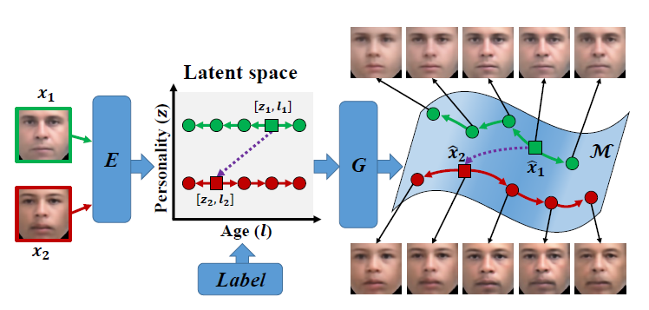
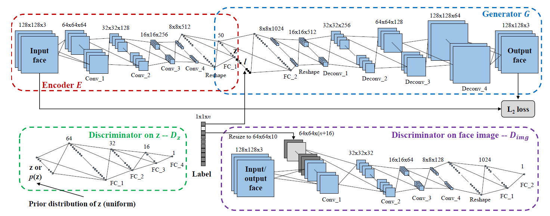
Related Work (4/4)
Deep Learning
Conditional Adversarial Autoencoder (CAAE)
Zhifei Zhang, Yang Song, Hairong Qi. Age Progression/Regression by Conditional Adversarial Autoencoder. CVPR, 2017

Slide 10
Approach (1/2)
Motivation
C1: identity preserving
C2: natural
C3: specific age
age
C1
Generator
？
C2
C3

Slide 11
Approach (2/2)
Framework
Attention Model
Generate identity preserving but age irrelevant latent vector
Multitask Learning
Generating image with specific age
IM: image
IMG: generated image
E: encoder
G: generator
D: discriminator
L1: reconstruction loss
L2: JS loss
L3: age classification loss
L1
Latent
IM
IMG
E
G
gate
join
L2
Age
D
L3

Slide 12
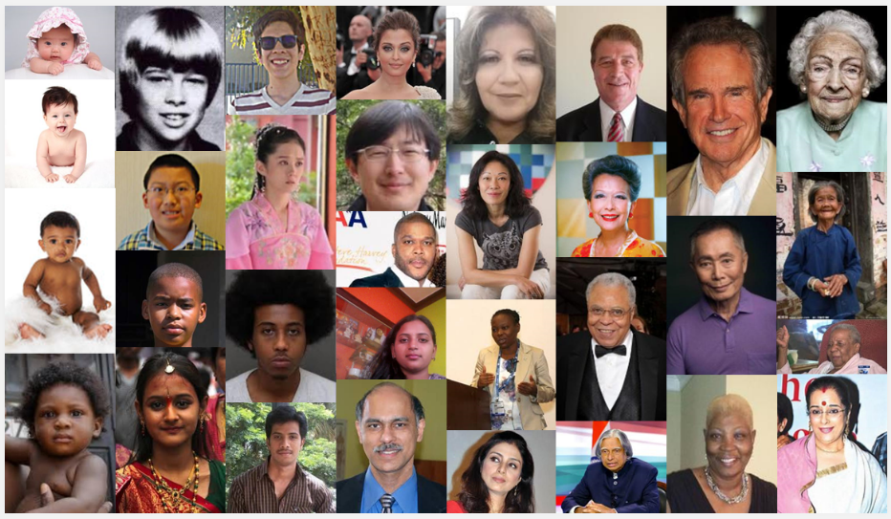
Experiment
Image Database（UTKFace）
20k+ face images in the wild
correspondingly aligned and cropped faces
corresponding landmarks (68 points)
age, gender, and ethnicity

Slide 13
Experiment
Some highlight results in our project.

Slide 14
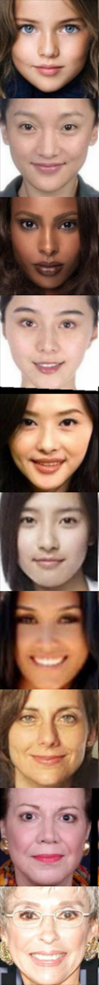
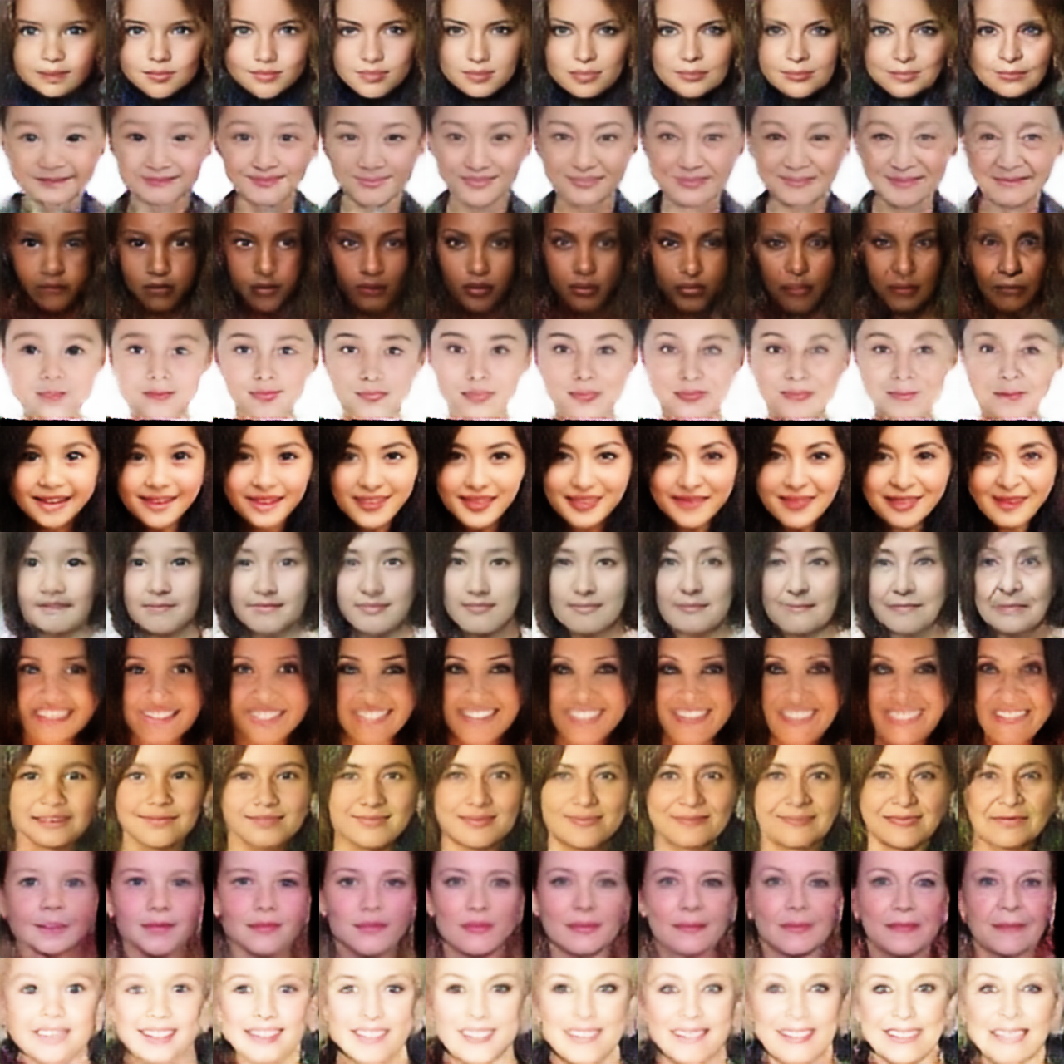
Experiment --- Some results in female
Input image
0
5
10
15
20
30
40
50
60
70

Slide 15

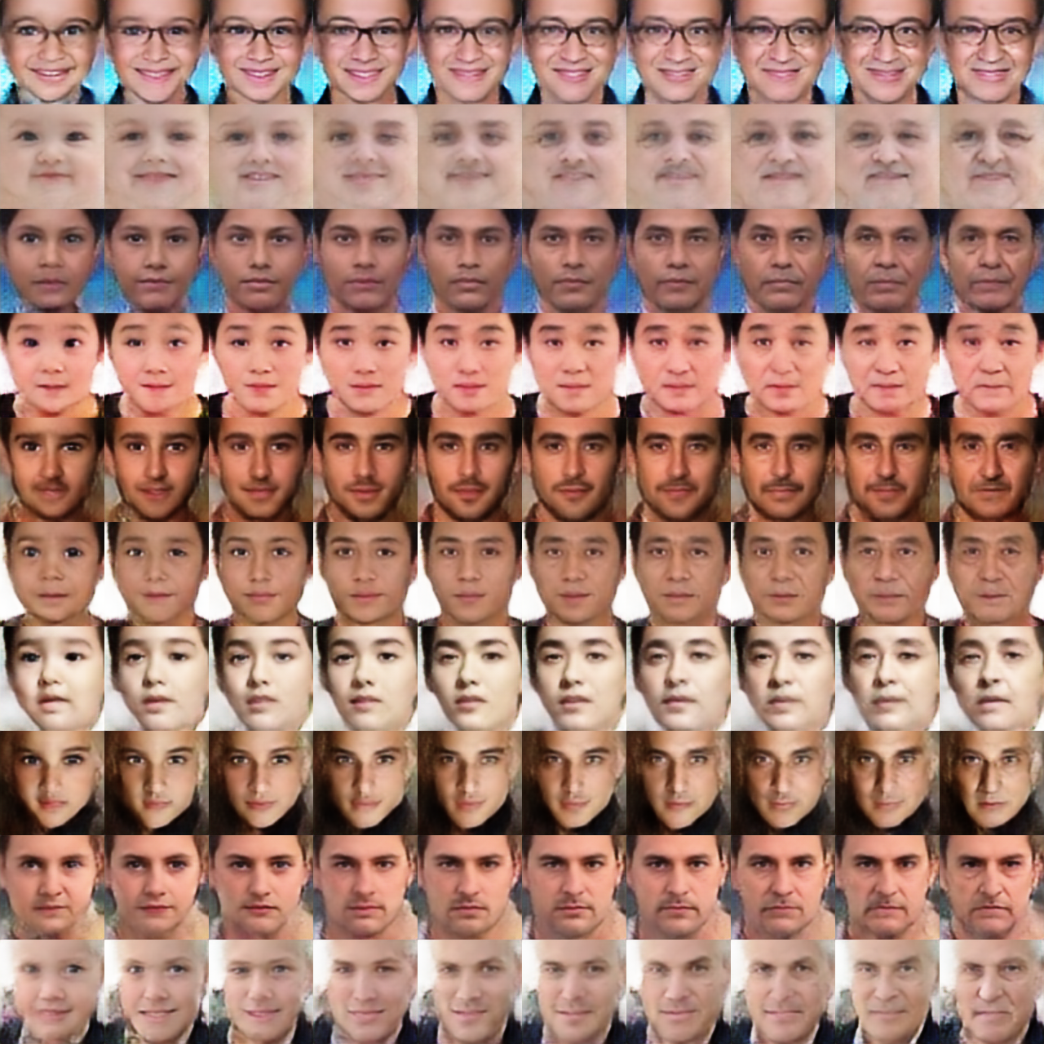
Experiment --- Some results in male
Input image
0
5
10
15
20
30
40
50
60
70

Slide 16
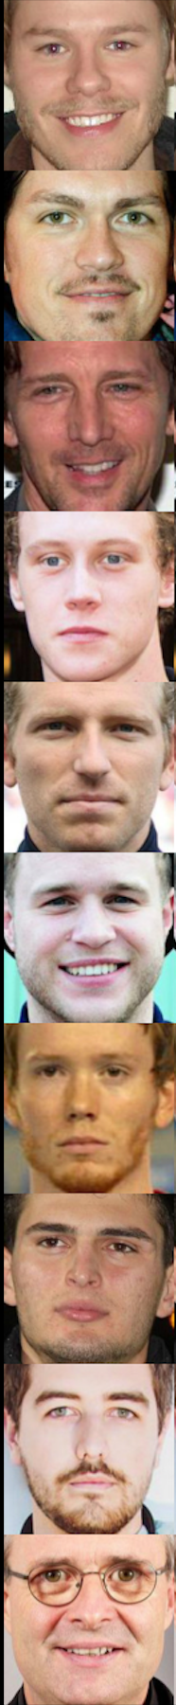
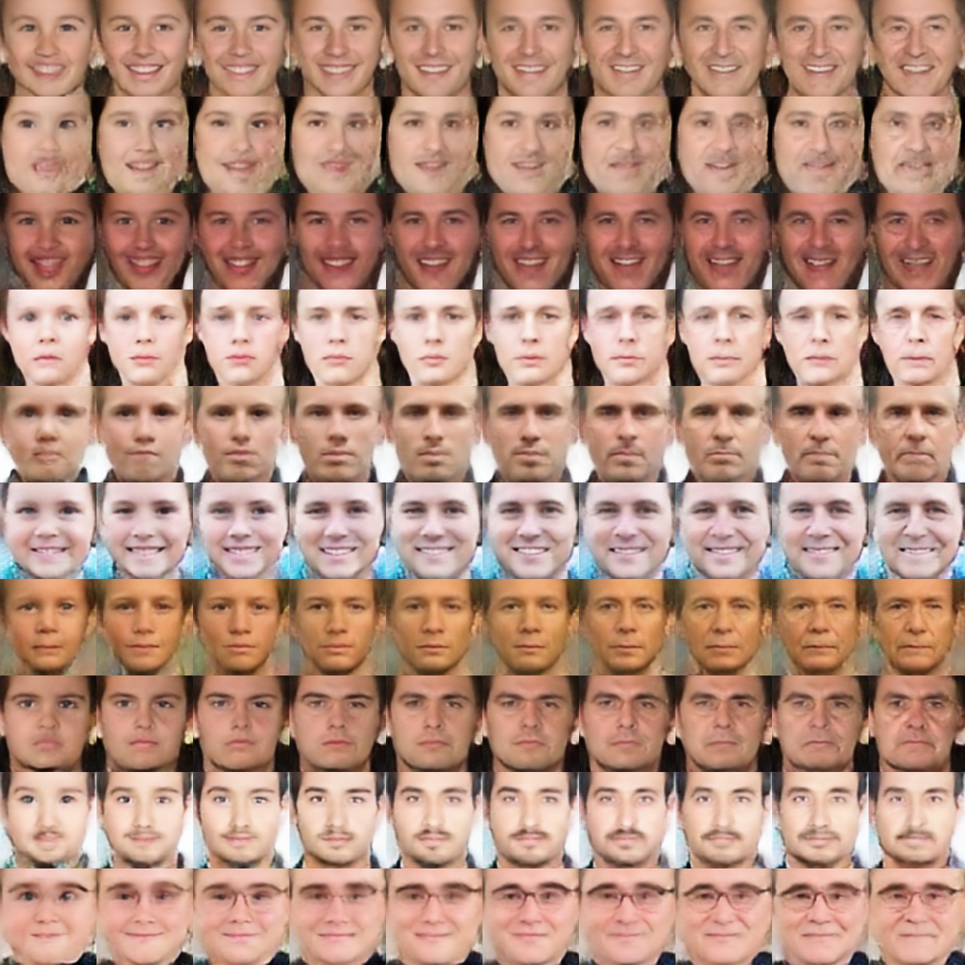
Experiment --- Some results in male
Input image
0
5
10
15
20
30
40
50
60
70

Slide 17
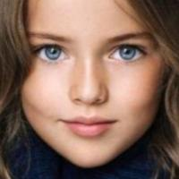
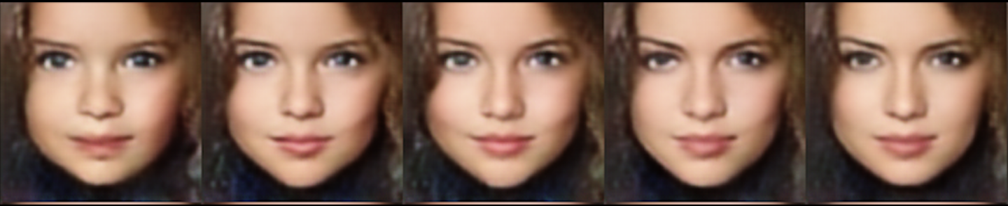
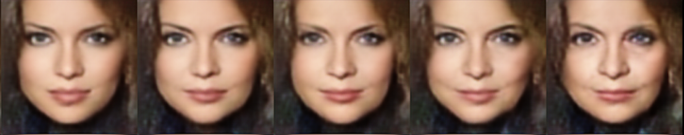

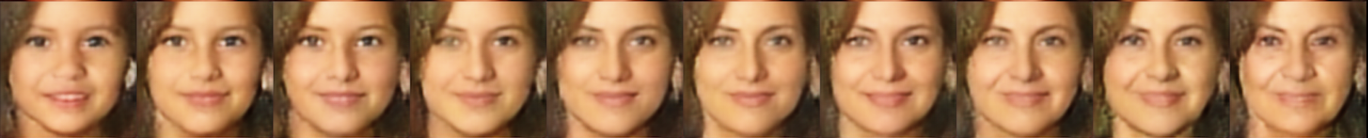
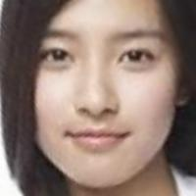
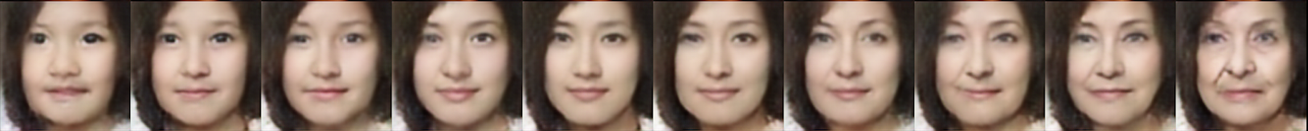
Experiment --- Some results in female
0-5
6-10
11-15
16-20
21-30
Input: 12 years old Euro girl
30-40
41-50
51-60
61-70
71-80
Input: 35 years old
0-5
6-10
11-15
16-20
21-30
31-40
41-50
51-60
61-70
71-80
Input: 26 years old

Slide 18
Experiment
Comparison with the CAAE.

Slide 19


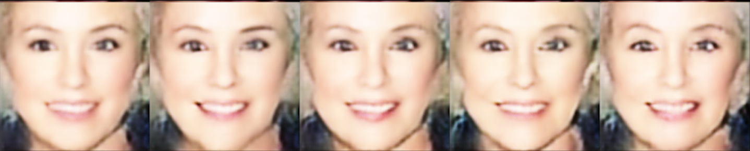

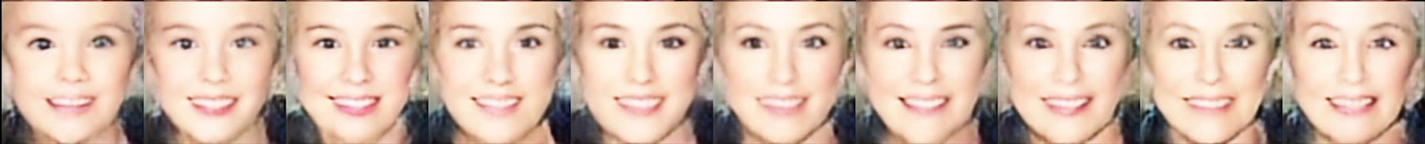
Experiment --- Comparison with the CAAE(1/2)
Age progression more obvious.
Ours
CAAE
Input: 64 years old woman
Ours
CAAE

Slide 20
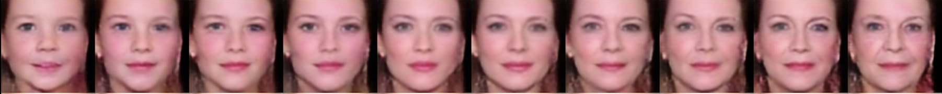


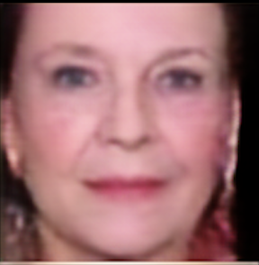
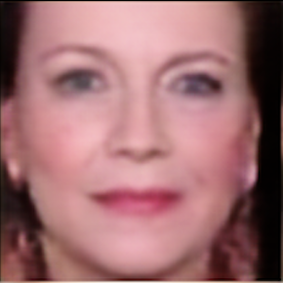

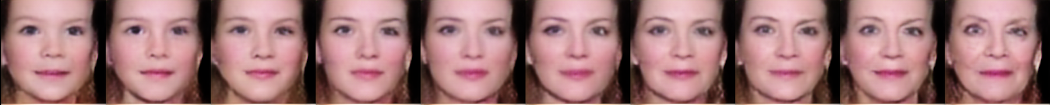
Experiment --- Comparison with the CAAE(2/2)
More natural
Ours
CAAE

Slide 21
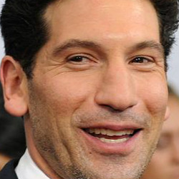
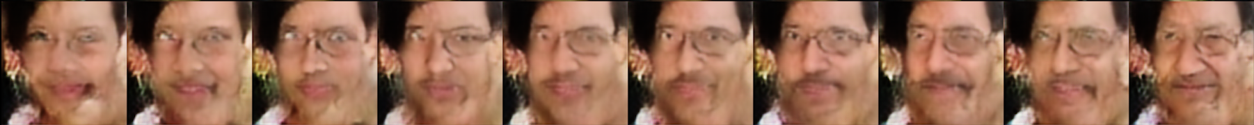
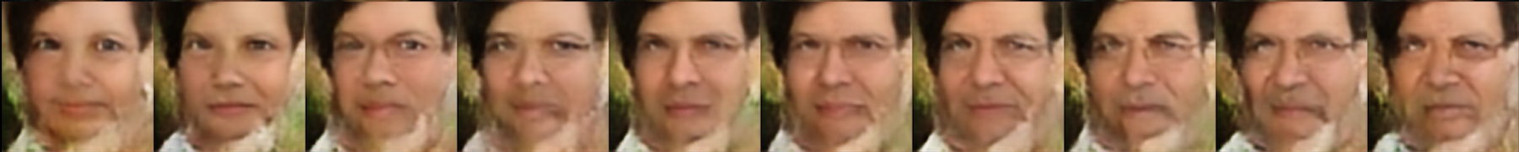
Experiment--- Test on a new database
Not a good performance
Background influence
CAAE
Ours

Slide 22
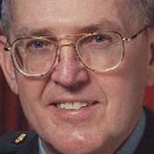
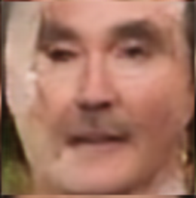
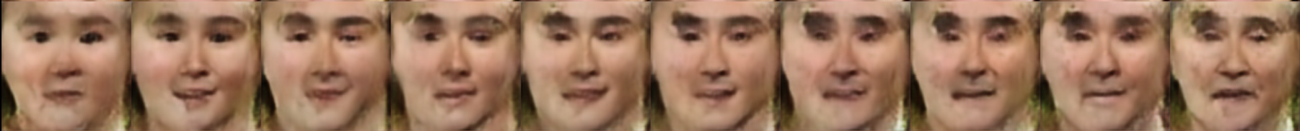
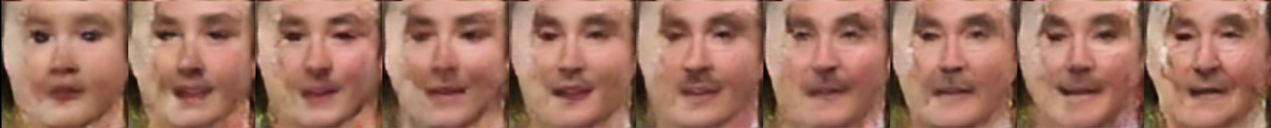
Experiment--- Test on a new database
Not a good performance
Local Identity Preserving
CAAE
Ours

Slide 23
Summary
Conclusion
Eye and cheek are important for age
Future Work
Deal with the generalization problem

Slide 24

Q&A

